Slide 1


Slide 2
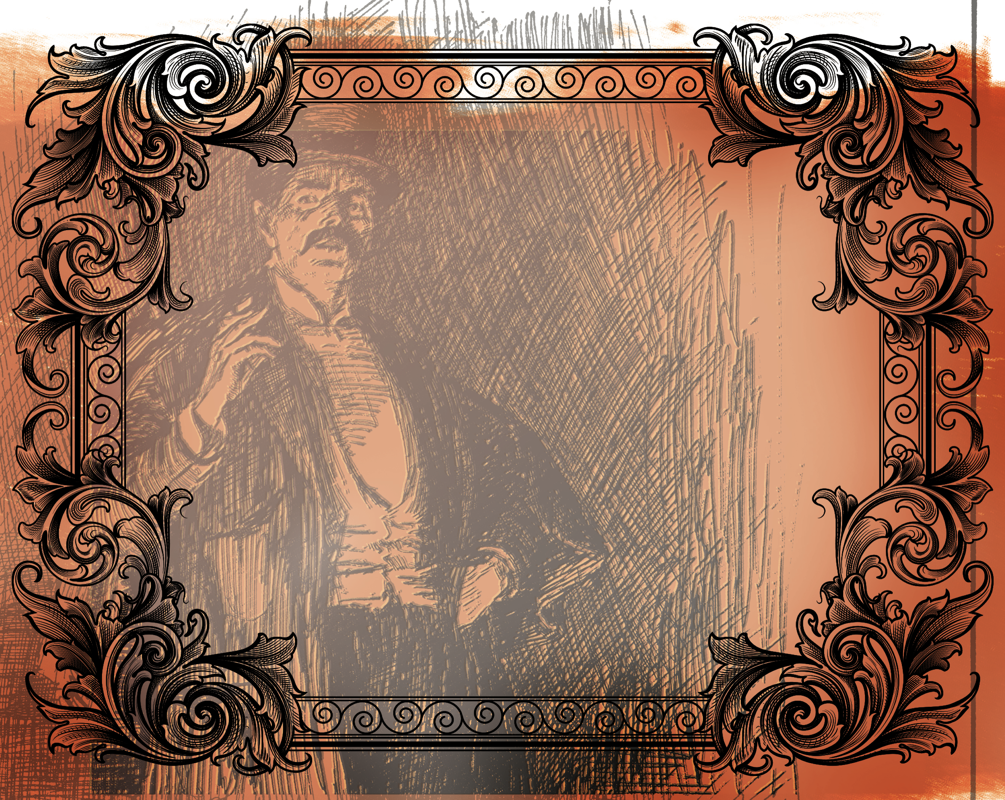
But love ye your enemies, and do good, and lend, hoping for nothing again; and your reward shall be great, and ye shall be the children of the Highest: for He is kind unto the unthankful and to the evil. Be ye therefore merciful, as your Father also is merciful.
^{Luke 6:35-36}

Slide 3
Jesus said to love our enemies.
Show your enemies compassion.
Show your enemies grace as you have been shown grace.

Slide 4
Enter Content Here.
Enter content here.
Enter content here
Enter content here

